Slide 1

Graph and Session

Slide 2
Reference
Youtube
Code

Slide 3
Warm Up

Slide 4
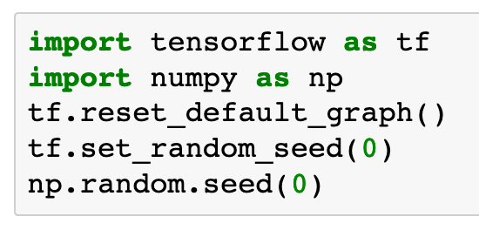

Slide 5
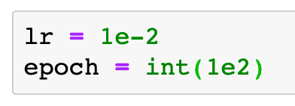

Slide 6
Data

Slide 8
Graph

Slide 9
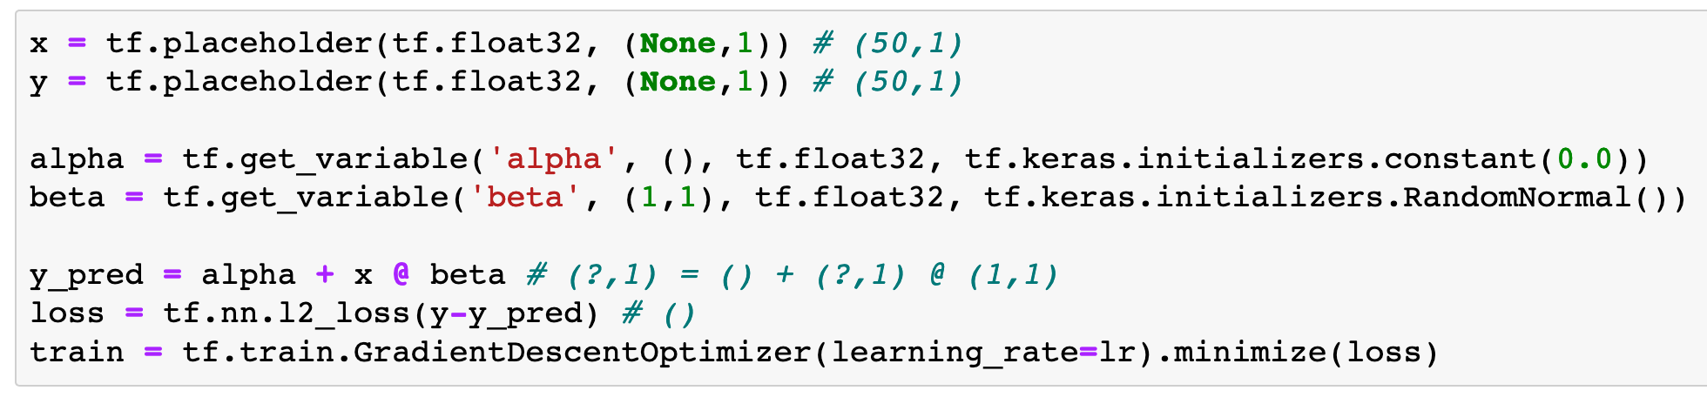

Slide 10
Session

Slide 11
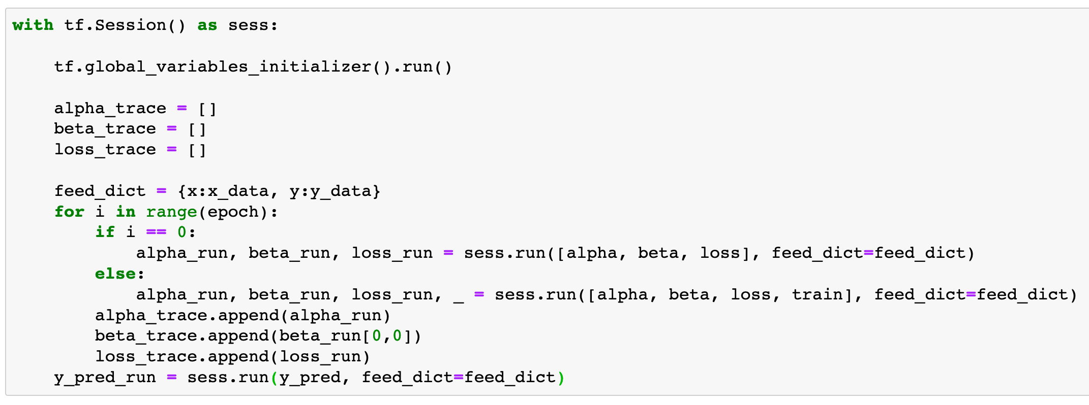

Slide 12
Report Result

Slide 13
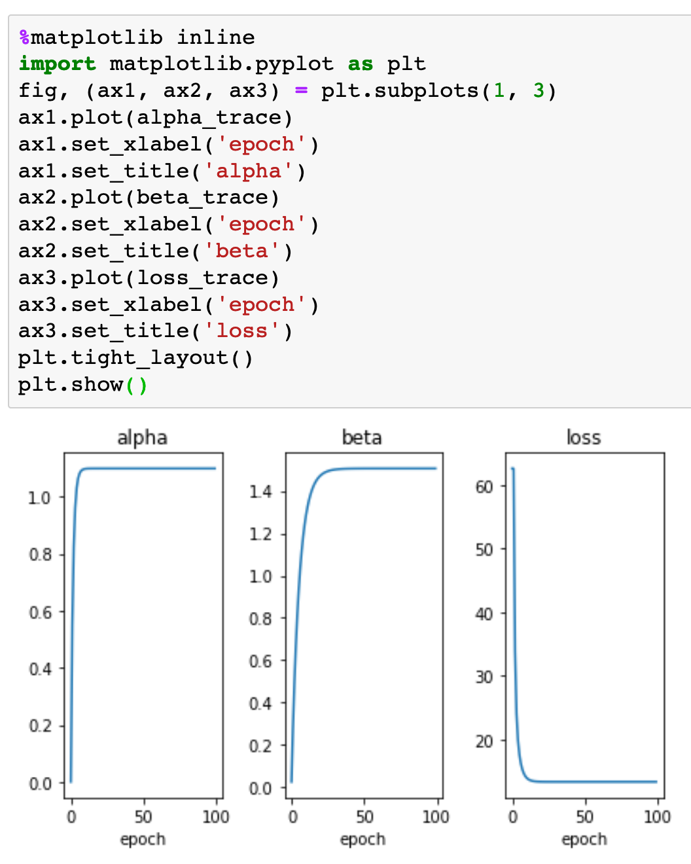

Slide 14
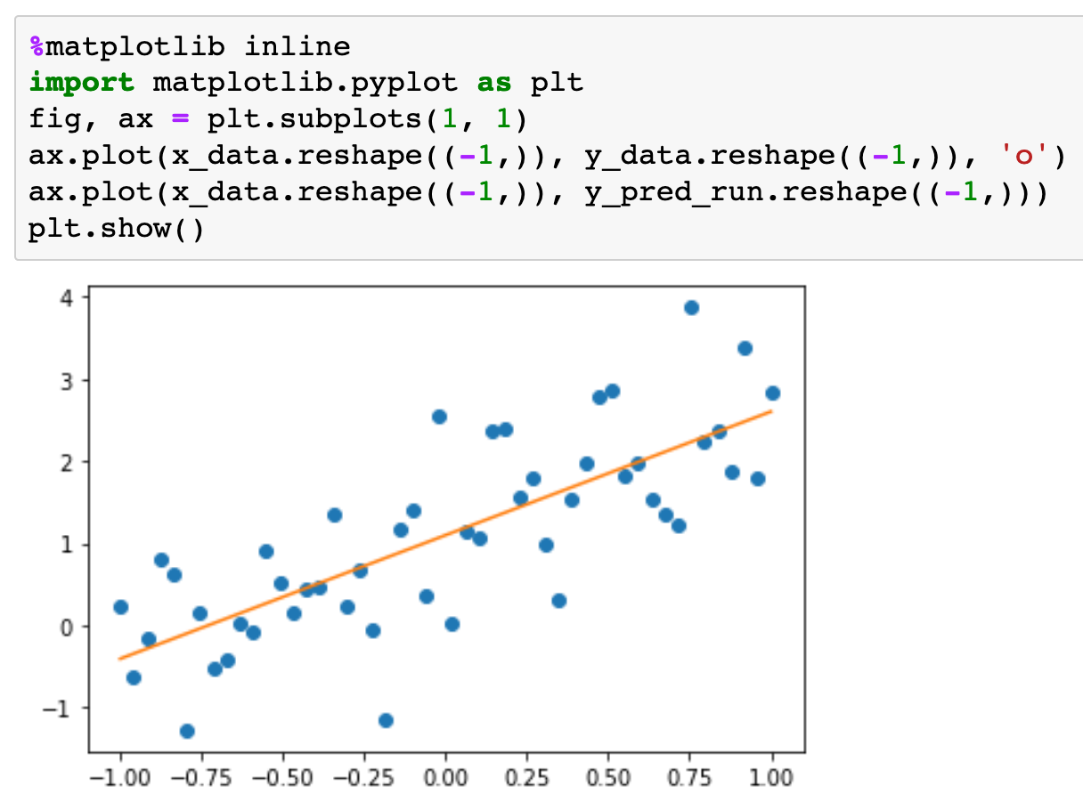

Slide 15
Exercise
Write and run a code to find the slope and intercept of the learned straight line. Do you recover the original slope 2 and intercept 1? Why or why not?

Slide 16
Now
Let’s Play with Code

